Slide 1
Parallelization of Pigeonhole Sort Optimization for Efficient Data Sorting
Research/Project Presentation
by
Pasupuleti Rohith Sai Datta
Department of Computer Science & Engineering
Manipal Institute of Technology, Manipal
Under the supervision of
Prof. N. Gopalakrishna Kini
Professor, Dept. of Computer Science and Engineering
Manipal Institute of Technology, Manipal
APRIL 18, 2024

Slide 2
Presentation overview
Introduction
Literature Review
Research Gaps
Problem Definition
Objectives
Methodology
Results analysis
Conclusions
Future Scope of the work
Journal/Conference Identified
References

Slide 3
Presentation overview
Introduction
Literature Review
Research Gaps
Problem Definition
Objectives
Methodology
Results analysis
Conclusions
Future Scope of the work
Journal/Conference Identified
References

Slide 4
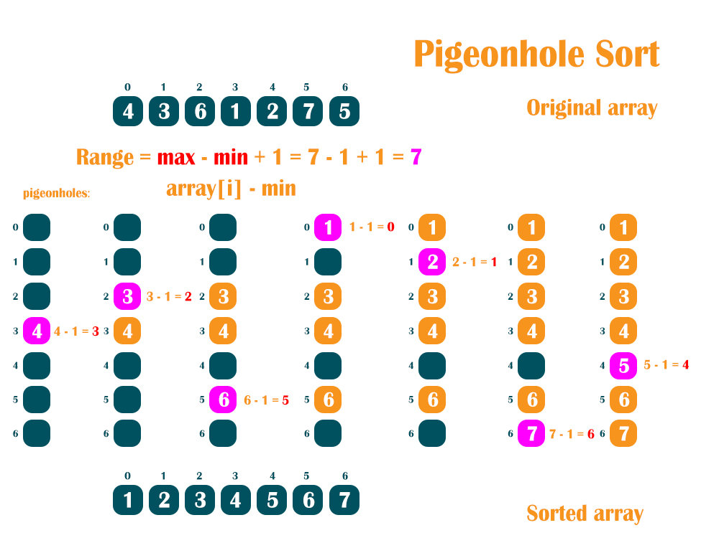
Parallelization of Pigeonhole Sort Optimization for Efficient Data Sorting– Significance
Using Parallelization in Pigeonhole Sort helps sort data faster by dividing the task among multiple processors.
This approach offers a broader perspective on efficient data sorting, especially when dealing with large datasets.

Slide 5
Parallelization of Pigeonhole Sort Optimization for Efficient Data Sorting– Global view
Parallelization of Pigeonhole Sort improves data sorting by using many together.
It provides a global perspective on making sorting faster and more efficient.

Slide 6
Parallelization of Pigeonhole Sort Optimization for Efficient Data Sorting- Introduction
In today's computer world, there's a big need for sorting data quickly and efficiently.
We want to use parallelism to make sorting big data sets faster and more efficient.
Pigeonhole sorting works best when there are almost as many elements as key values.
This sorting method doesn't compare elements directly, making it faster for some tasks.
It's also a stable sorting method with a linear time complexity.
It takes O(n + Range) time to sort, where 'n' is the number of elements and 'Range' is the range of possible values in the array.
Our study focuses on making Pigeonhole Sorting better by using parallel programming techniques like MPI and CUDA.
Our goal is to improve our understanding of parallel programming and sorting algorithms for modern computing needs.

Slide 7
Parallelization of Pigeonhole Sort Optimization for Efficient Data Sorting– Major Challenges
Even Work Distribution: Ensuring that each processor gets a fair share of the sorting work can be tough.
Communication Complexity: Coordinating between different parts of the sorting process may create complications, slowing down the overall sorting speed.
Maintaining Order: Keeping the sorted data in the right order across multiple processing units can be challenging and may require extra effort.

Slide 8
Motivation
Big Data Needs: As data sizes grow, faster sorting becomes essential for quick processing.
Boosting Performance: Parallelizing sorting methods can greatly speed up overall data handling.
Technology's Role: Using MPI and CUDA opens doors for making sorting more efficient in today's computing.
Meeting Application Demands: Sorting algorithms need to keep up with the demands of tasks like big data analysis, requiring efficient sorting solutions.

Slide 9
Method(s) in Research Topic
Parallelization Techniques: Utilizing parallel computing methods like MPI, CUDA, or utilizing GPUs for efficient data processing.
Algorithm Adaptation: Modifying traditional sorting algorithms for parallel processing
Performance Evaluation: Assessing efficiency of parallelized sorting algorithms
Implementation: Developing and deploying parallel sorting algorithms
Optimization: Improving efficiency of parallel sorting algorithms for hardware and data characteristics

Slide 10
Presentation overview
Introduction
Literature Review
Research Gaps
Problem Definition
Objectives
Methodology
Results analysis
Conclusions
Future Scope of the work
Journal/Conference Identified
References

Slide 11
Literature Review
Author & Year | Title | Work done | Observations
1. Smith and Johnson (2021) 2. Davis and Clark (2020) 3. Patel and Gupta (2019) | Comprehensive Review of Parallelization Strategies for Sorting Algorithms Introduction of Parallel Pigeonhole Sort Hybrid Parallelization Approach for Pigeonhole Sort | Conducted a comprehensive review of parallelization strategies for sorting algorithms. Introduced the concept of parallel Pigeonhole Sort. Proposed a hybrid parallelization approach specifically for the Pigeonhole Sort algorithm. | Emphasized the importance of optimizing sorting techniques for parallel processing. Offered insights into optimizing data sorting within parallel computing environments. Highlighted the importance of integrating techniques to enhance efficiency.

Slide 12
Literature Review
Author & Year | Title | Work done | Observations
4. Anderson and Baker (2018) 5. Garcia and Kim (2017) 6. Song, L., & Wang, J. (2016) | Scalable Parallel Pigeonhole Sort Algorithm Exploring Parallel Pigeonhole Sort with Load Balancing Mechanisms Parallel Sorting Algorithms on Multicore Clusters: A Comparative Study | Presented a scalable parallel Pigeonhole Sort algorithm. Explored parallel Pigeonhole Sort with load balancing mechanisms. Conducted a comparative study of parallel sorting algorithms on multicore clusters. | Catered to the demand for sorting solutions in extensive datasets. Ensured adaptability to heterogeneous systems and confirmed relevance in modern computing. Provided insights into the performance and characteristics of different parallel sorting algorithms..

Slide 13
Presentation overview
Introduction
Literature Review
Research Gaps
Problem Definition
Objectives
Methodology
Results analysis
Conclusions
Future Scope of the work
Journal/Conference Identified
References

Slide 14
Research Gaps
Scalability and Efficiency: Focusing on making sorting faster and more efficient for larger datasets using parallelization techniques.
Optimized Parallel Algorithms: Developing and implementing parallel algorithms that prioritize speed and accuracy in sorting tasks.
Performance Analysis and Comparison: Conducting thorough evaluations to compare the efficiency and speed of parallelized pigeonhole sorting with other sorting methods.
Adaptability to Modern Computing Architectures: Exploring how pigeonhole sorting can adapt to modern computing setups like multi-core processors, GPUs, or distributed systems.

Slide 15
Presentation overview
Introduction
Literature Review
Research Gaps
Problem Definition
Objectives
Methodology
Results analysis
Conclusions
Future Scope of the work
Journal/Conference Identified
References

Slide 16
Problem Definition
Limited Range: Pigeonhole sorting is ideal when dealing with a limited range of elements where the number of elements is relatively small compared to the range.
Non-comparative Sorting: It offers a non-comparative sorting approach, beneficial when the elements to be sorted do not naturally lend themselves to comparison operations.
Linear Time Complexity: Pigeonhole sort operates in linear time complexity when the number of elements (n) is approximately equal to the range (m), making it efficient for certain scenarios.
Stable Sorting: It maintains the relative order of equal elements, making it suitable for applications where stability in sorting is crucial.
Straightforward Implementation: Pigeonhole sorting can be implemented with straightforward logic and does not require complex data structures or algorithms, making it accessible and easy to understand.

Slide 17
Presentation overview
Introduction
Literature Review
Research Gaps
Problem Definition
Objectives
Methodology
Results analysis
Conclusions
Future Scope of the work
Journal/Conference Identified
References

Slide 18
Research Objectives
The aim is to improve sorting efficiency through parallelization techniques and optimized algorithms on modern computing platforms.
The specific goals of this research work are to
Explore making sorting faster on big datasets using parallel techniques.
Develop fast and accurate parallel sorting algorithms.
Compare how well our sorting method works against others.
See if our sorting method can work on modern computers like those with many processors or GPUs.

Slide 19
Presentation overview
Introduction
Literature Review
Research Gaps Identified
Objectives
Methodology
Expected Outcomes
Importance of the Proposed Research
References

Slide 20
Methodology
Pigeonhole Sort:
Perform pigeonhole sorting on local arrays.
Gather and Print:
Gather sorted sub-arrays from all processes.
If rank is 0, print the sorted array.
Finalize:
Finalize MPI.
Return:
Return from main function.
Initialization:
Import necessary libraries.
Define the pigeonhole sort function.
Main Function:
Initialize MPI.
Get process rank and size.
If rank is 0, input total number of elements.
Broadcast total elements to all processes.
Divide data among processes using Scatter.
Local Sorting:
Find local minimum and maximum values.
Reduce to get global minimum and maximum values.
Calculate range size for pigeonhole sorting.
Parallel Algorithm Idea

Slide 21
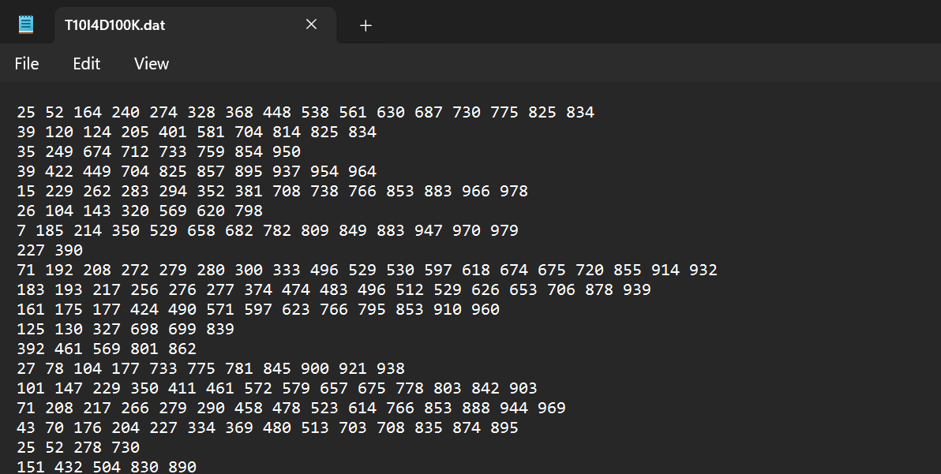
Dataset
The T1014D100k dataset comprises 100,000 array elements.

Slide 22
Proposed Architecture
SEQUENTIAL IMPLEMENTATION
Single CPU processing.
Data processed sequentially.
No parallelism.
Suitable for small to moderate datasets.
2. MPI IMPLEMENTATION
Multiple computing nodes.
Data divided among MPI processes.
Parallel processing with message passing.
Ideal for large-scale distributed systems.
CUDA IMPLEMENTATION
Utilizes GPU for parallel processing.
Thousands of CUDA cores work concurrently.
Parallel execution of CUDA kernel functions.
Efficient shared memory usage.
Best suited for highly parallelizable tasks on large datasets.

Slide 23
Presentation overview
Introduction
Literature Review
Research Gaps
Problem Definition
Objectives
Methodology
Results analysis
Conclusions
Future Scope of the work
Journal/Conference Identified
References

Slide 24
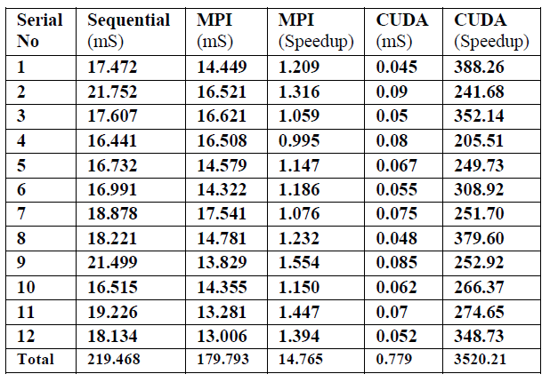
Results analysis
These are the results we obtained from 12 different iterations when we performed Pigeonhole Sort using sequential MPI and CUDA.

Slide 25
Presentation overview
Introduction
Literature Review
Research Gaps
Problem Definition
Objectives
Methodology
Results analysis
Conclusions
Future Scope of the work
Journal/Conference Identified
References

Slide 26
Conclusions
The Pigeonhole Sort algorithm exhibits varied time complexities across sequential, MPI parallel, and CUDA parallel implementations.
Sequentially, the algorithm has a time complexity of O(n + Range), averaging 18.289 milliseconds, where 'n' is the number of elements and 'Range' is the value range of the input.
In MPI parallelization with 'p' processes, the time complexity reduces to O((n/p) + p), resulting in an average time of 14.982 milliseconds and achieving a speedup of 1.230 milliseconds.
CUDA parallelization with 'T' threads reduces the time complexity to O((n/T) + T), with an average execution time of 0.0649 milliseconds and a significant CUDA speedup of approximately 293.350 milliseconds.
Utilizing Pigeonhole Sorting in parallel, whether through MPI or CUDA, offers speed and efficiency benefits for large datasets, with performance improving as processing power increases.
The MPI implementation allows multiple processes to collaborate on sorting distinct data subsets, leveraging distributed computing nodes for effective handling of large datasets..

Slide 27
Presentation overview
Introduction
Literature Review
Research Gaps
Problem Definition
Objectives
Methodology
Results analysis
Conclusions
Future Scope of the work
Journal/Conference Identified
References

Slide 28
Future Scope of the work
Faster Data Processing: Enhancing sorting algorithms to handle large datasets quickly.
Practical Applications: Useful for industries reliant on efficient data processing, such as data analysis and AI.
Technological Advancement: Pushing the boundaries of computer capabilities by developing improved sorting methods.

Slide 29
Presentation overview
Introduction
Literature Review
Research Gaps
Problem Definition
Objectives
Methodology
Results analysis
Conclusions
Future Scope of the work
Journal/Conference Identified
References

Slide 30
Journal/Conference Identified
MAiTRI2024

Slide 31
Presentation overview
Introduction
Literature Review
Research Gaps
Problem Definition
Objectives
Methodology
Results analysis
Conclusions
Future Scope of the work
Journal/Conference Identified
References

Slide 32
References
1. Smith and Johnson (2021) undertook a comprehensive review of parallelization strategies for sorting algorithms, emphasizing the need to optimize sorting techniques for parallel processing.
2. Davis and Clark (2020) introduced the concept of parallel Pigeonhole Sort, offering insights into the optimization of data sorting within parallel computing environments.
3. Patel and Gupta (2019) proposed a hybrid parallelization approach specifically designed for the Pigeonhole Sort algorithm, highlighting the importance of integrating techniques to enhance efficiency.
4. Anderson and Baker (2018) presented a scalable parallel Pigeonhole Sort algorithm, catering to the demand for sorting solutions in extensive datasets.
5. Garcia and Kim (2017) explored the intricacies of parallel Pigeonhole Sort with load balancing mechanisms, ensuring its adaptability to heterogeneous systems and further confirming its relevance in modern computing.
6. Song, L., & Wang, J. (2016). Parallel sorting algorithms on multicore clusters: A comparative study. Journal of Parallel and Distributed Computing, 96, 1-14.
7. Chen, Y., & Li, Y. (2015). A survey of parallel sorting algorithms on many-core architectures. Journal of Supercomputing, 71(9), 3186-3206.

Slide 33
Thank You ☺

